Slide 1


Microservices, Messaging and Apache Kafka - May 2023
Lucas Jellema Architect & CTO AMIS | Conclusion
labs: github.com/lucasjellema/fontys-spring2023-microservices-messaging-kafka
Notes:
Wat is een microservice? (waarom, problemen met monolitische applicaties, hoe microservice architectuur, generieke voorzieningen & platform voor microservices, data & events als glue tussen microservices)
Hier alvast stilstaan bij het belang van een event broker en een korte intro van Kafka (meer in college 2)
Implementatie van microservices: afhandelen van http requests, consumeren en publiceren van events, doen van http calls: wat zijn activiteiten die iedere microservice moet uitvoeren? (state mgt, pub/sub, secrets, config mgt, aanroepen 3rd party (cloud) services, ..)
Introductie en demo van Dapr.io framework – de personal assistant die iedere applicatie eenvoudig laat aansluiten op generieke voorzieningen én die applicaties (microservices) met elkaar laat interacteren op ontkoppelde wijze; note: ik zal wijzen op de ondersteuning in Dapr.io voor diverse technologieën zoals RabbitMQ, MySQL, Redis
Handson met Dapr – meegeleverde applicaties in Java en C#
Zelf implementeren van microservice – introductie van NodeJS ;
Handson: afbouwen eenvoudige services in NodeJs en via Dapr.io interactie met elkaar en met generieke voorzieningen

Slide 2




90 colleagues, located in Nieuwegein
Founded in 1991 by students from University of Twente – Aircraft Maintenance Information System (AMIS)
the core of what we do: working with Data.
partnering with peers and companies in several countries
Lucas Jellema (2002)
Cloud Solution Architect & CTO
lucas.jellema@amis.nl | technology.amis.nl | @lucasjellema | lucas-jellema

Slide 3
Data & Application Integration
cloud, DevOps, PaaS, streaming, microservices, Software Studio, database, software engineering
web applications
Data Engineering, Data Analytics (& Data Science)
Oracle, Microsoft Azure, open source, Java, SQL, NodeJS, Python, Kafka React/Angular
Internet of Things

Slide 4



























Slide 5











Slide 6
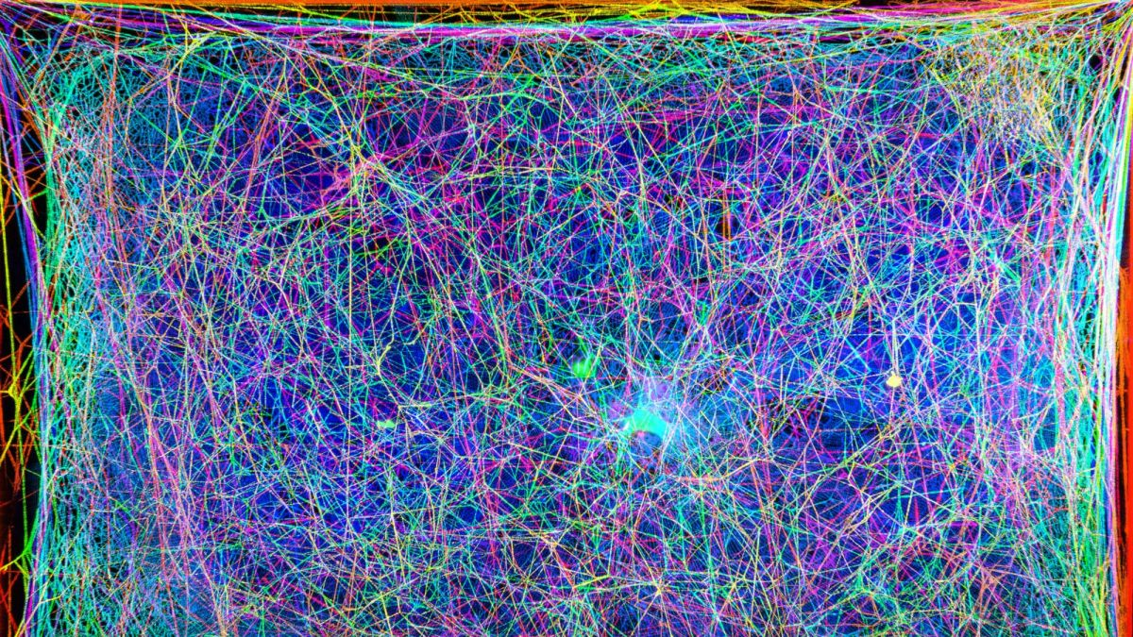





































Slide 7
and you are invited to come do an internship and explore job opportunities with us!

Slide 8

Moving On. Our Main Story today
Data
Integration
in an asynchronous way
Using:
Apache Kafka – distributed message broker, enterprise backbone

Slide 9


Overview
Asynchronous communication – Messaging for people and systems
Introducing Apache Kafka – what, why, when, how
Handson with Apache Kafka
Microservices
Programmatic interaction with Apache Kafka (from Node)
Handson Asynchronous interactions through Node and Apache Kafka
also: Python, Java, Go, .NET/C#

Slide 10
Assumed is
A GitHub account
Knowledge of
HTTP, REST, JSON
JavaScript/Node, Python, Java or C#
VS Code (or another IDE)
Containers and Docker (Compose)
Cloud fundamentals
Microservices concepts

Slide 11
What is Integration?

Slide 12
Data & Integration
Data
Where
When
How
it is required

Slide 13
Synchronous
push
pull
Notes:
push to API (when I have it), fetch from API (when I need it)
high coupling

Slide 14
Synchronous
hard to handle peak loads
brittle
push
pull
high degree of coupling
blocking
Notes:
push to API (when I have it), fetch from API (when I need it)
high coupling

Slide 15
Asynchronous
push
pull
Notes:
push to API (when I have it), fetch from API (when I need it)
high coupling

Slide 16
Asynchronous – Data Provider does not depend on Data Consumer
push
pull
Notes:
push to API (when I have it), fetch from API (when I need it)
high coupling

Slide 17
Asynchronous – Data Consumer does not depend on Data Provider
push
pull
Notes:
push to API (when I have it), fetch from API (when I need it)
high coupling

Slide 18
Asynchronous
push
pull
Notes:
push to API (when I have it), fetch from API (when I need it)
high coupling

Slide 19




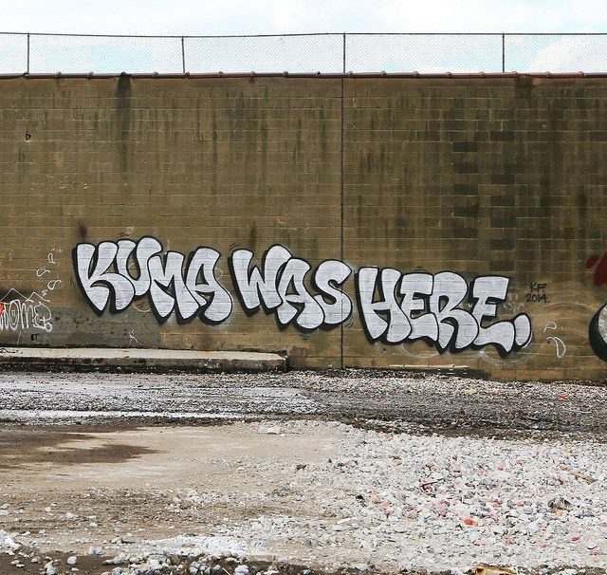

Asynchronous
push
pull
Notes:
push to API (when I have it), fetch from API (when I need it)
high coupling

Slide 20
Asynchronous
email
ftp
file system
queue
database
cache
message broker
push
pull
Notes:
push to API (when I have it), fetch from API (when I need it)
high coupling

Slide 21





Slide 22
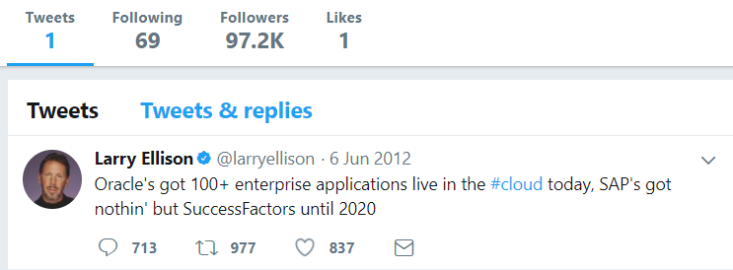
Heck, I do not even know these people and they may not know me [personally] – just my pearls of wisdom. And if they are late to the party, they can also check out the historic archives of my eloquence
Without fretting about the numbers of readers involved and whether they are in the same time zone as me and online when I publish my messages – and which device they use
It would be so nice if I could publish my ideas and actions, accessible near instantly for everyone who is interested

Slide 23
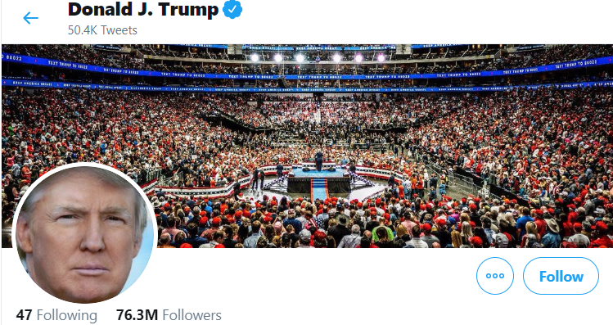
Heck, I do not even know these people and they may not know me [personally] – just my pearls of wisdom. And if they are late to the party, they can also check out the historic archives of my eloquence
Without fretting about the numbers of readers involved and whether they are in the same time zone as me and online when I publish my messages – and which device they use
It would be so nice if I could publish my ideas and actions, accessible near instantly for everyone who is interested

Slide 24
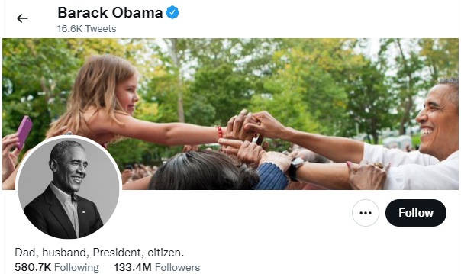
Heck, I do not even know these people and they may not know me [personally] – just my pearls of wisdom. And if they are late to the party, they can also check out the historic archives of my eloquence
Without fretting about the numbers of readers involved and whether they are in the same time zone as me and online when I publish my messages – and which device they use
It would be so nice if I could publish my ideas and actions, accessible near instantly for everyone who is interested

Slide 25

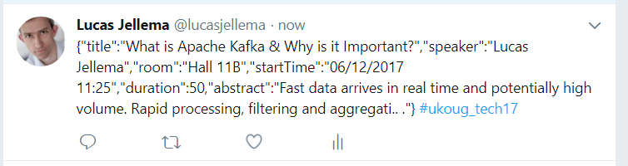
Decoupled communication
0, 1 or many followers
Scalable number of messages (and parties)
Reliable (mostly available, few messages lost)
Full history
Open: cross device, cross location
Not Sub-second, near real-time fast
Rate limited (#messages/minute)
Size limited (140-280 characters)
Format limited (text)
Not for private interactions
Not (really) for programmatic use

Slide 26

What does the Twitter for System Driven Event Interaction look like?
Decoupled communication – organized per topic
0, 1 or many Consumers per Topic
Scalable number of messages (and parties)
Reliable (distributed)
Full history
Open: libraries in many technologies & REST APIs

Slide 27
What does the Twitter for System Driven Event Interaction look like?
Decoupled communication – organized per topic
0, 1 or many Consumers per Topic
Scalable number of messages (and parties)
Reliable (distributed)
Full history
Open: libraries in many technologies & REST APIs
Near real-time fast
No Rate Limit
No enforced size limit
Anything goes (it’s all byte[])
On premises or in cloud, private or trusted
Very much for programmatic use

Slide 28
Events
Consumers
Producers
Robust, QoS, Scalable, Fast, History Retention
Order preserved
Containerized/Cloud-enabled
Open

Slide 29
Messaging as we know it
JMS, IBM MQ, MS MQ, RabbitMQ, MQTT, XMPP, WebSockets, Apache ActiveMQ, Database, (in memory) Cache, …
Challenges
Costs
Scalability (size and speed)
(lack of) Distribution (and therefore availability)
Complexity of infrastructure
Message delivery guarantees (reliability)
Lack of technology openness
Deal with temporarily offline consumers
Retain history

Slide 30

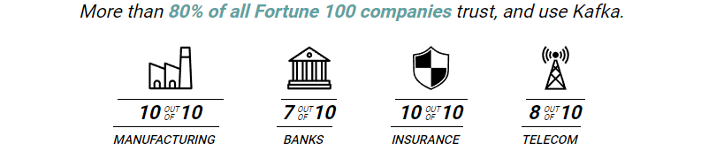

Introducing Apache Kafka
..- 2010 – creation at Linkedin
Message Bus | Event Broker | Event Store | Data Store
High volume, low latency, highly reliable, cross technology
Scalable, distributed, strict message ordering, ….
2011/2012 – open source under the Apache Incubator/ Top Project
Kafka is used by many large corporations
… and embraced by many software vendors & cloud providers
Commercial backing by and Enterprise support from Confluent

Slide 31
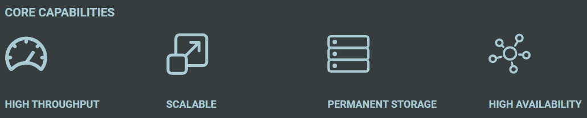
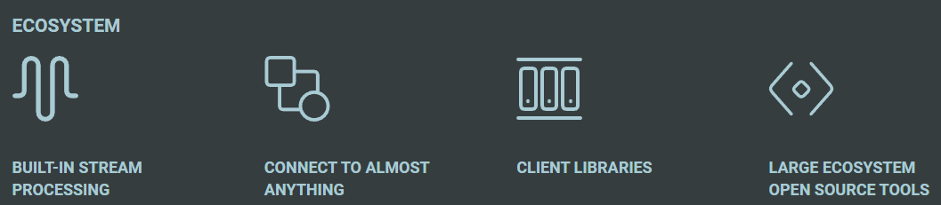


Slide 32
Consumers
tcp
Producers
tcp
Client polls Event Broker for messages

Slide 33
Kafka terminology
Topic
Message
== ByteArray
Broker
Producer
Consumer
Offset
Message
Key
Value
Time
Producer
Consumer
Broker
Topic
offset (for a specific consumer)

Slide 34
Key
Value
Time
Consumers
Producers
Broker
Topic

Slide 35
Consuming
Messages are available to consumers only when they have been committed by the producer
Kafka does not push
Kafka keeps track of offset of consumers
Read does not destroy
(some | much | all) History available
Offline or new consumers can catch up
Consumers can re-consume from the past
Delivery Guarantees
Ordering maintained
At-least-once (per consumer) by default; at-most-once and exactly-once can be implemented

Slide 36
The company bulletin board
!
!
!
!!
!!
“@#”

Slide 37



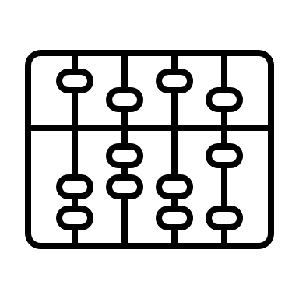

The company bulletin board
!
€
!
!!
“@#$”
$
¥ ₤ ₨

Slide 38
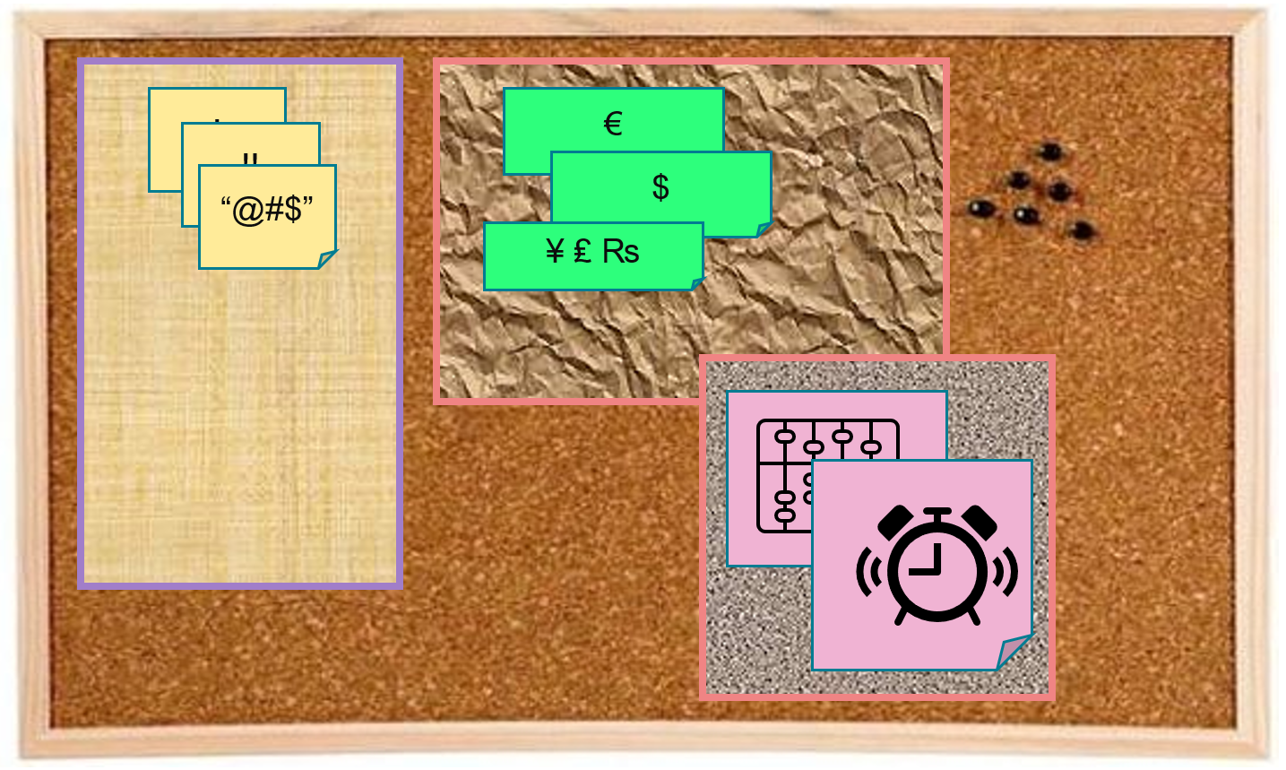
Key
Value
Time
Consumers
Producers
Broker
Topic
Message Log

Slide 39


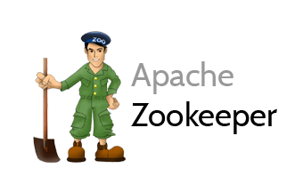
Cluster
Consumers
tcp
Producers
tcp
Broker
Topic

Slide 40
Cluster
Consumers
tcp
Producers
tcp
Broker
Topic
Partition
Consumer Group (team of collaborating consumers)
Partition Log
Replica

Slide 41
Cluster
Consumers
Consumer Group
each consumer group consumes all messages (once)
each consumer in a group consumes from one or more partitions (no partition is consumed by more than one consumer in a group)
when more consumers in a group than partitions in the topic, some consumers get no messages
when consumers disappear from a group, their partition(s) are reassigned to other consumers in the group
Producers
tcp
Broker
Topic
Partition
Consumer Group
Partition Log
Replica

Slide 42

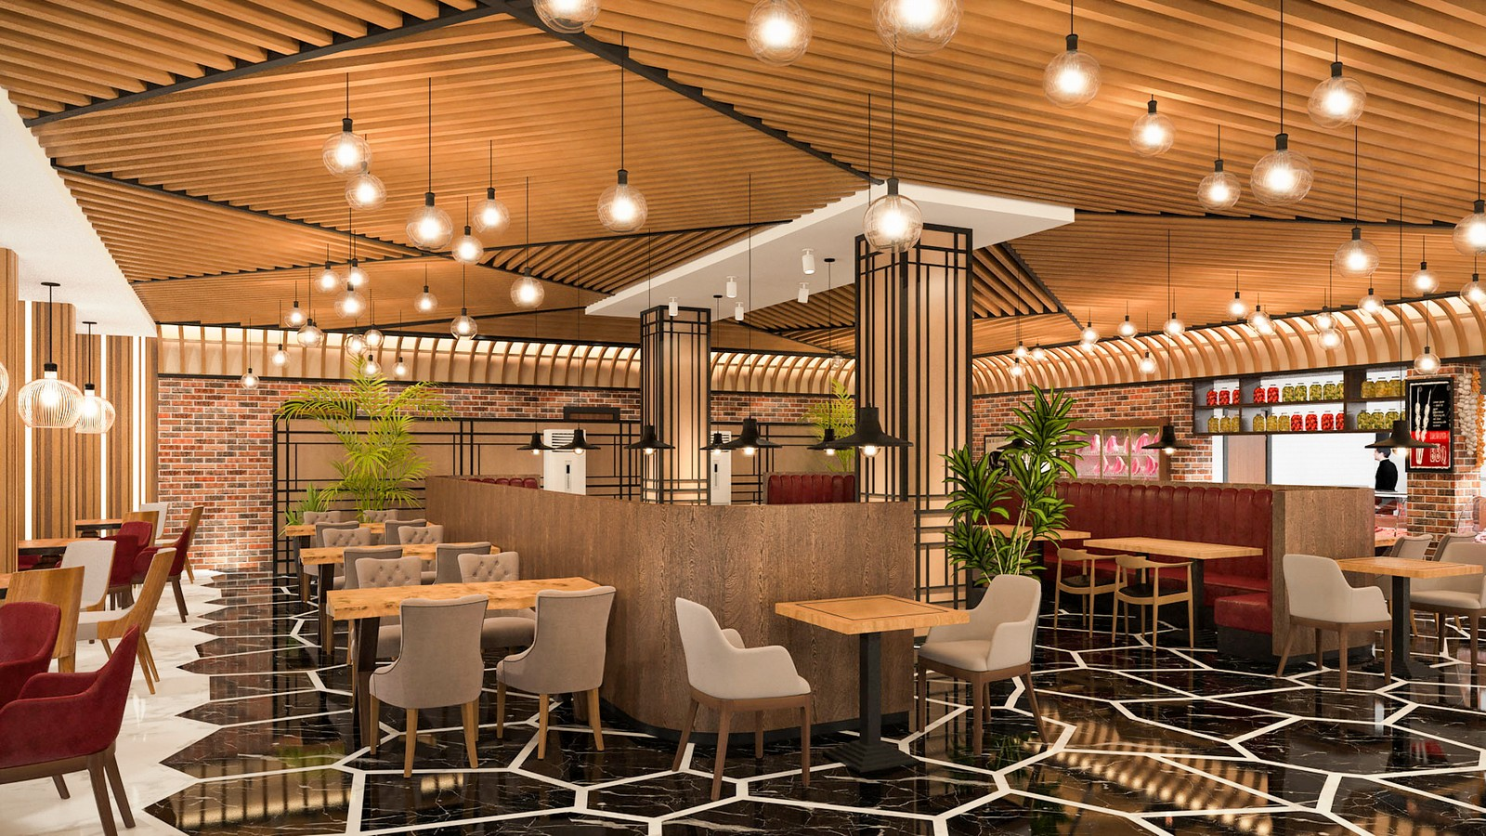






The Restaurant
Indoor Dining Area
Kitchen
Terrace

Slide 43




The Restaurant
Indoor Dining Area
Kitchen
Orders Placed
Terrace
Orders Prepared

Slide 44


The Restaurant
Indoor Dining Area
Bar
Orders Placed
Kitchen
Terrace
Orders Prepared

Slide 45
The Restaurant
Indoor Dining Area
Bar
Orders Placed
Kitchen
indoor orders
terrace
orders
Terrace
Orders Prepared

Slide 46
The Restaurant
Indoor Dining Area
Bar
Orders Placed
Kitchen
indoor orders
terrace
orders
Terrace
Orders Prepared

Slide 47
The Restaurant
Indoor Dining Area
Bar
topic
consumer
producer
Orders Placed
partition
Kitchen
indoor orders
consumer
terrace
orders
Terrace
Orders Prepared
consumer group

Slide 48
The Restaurant
Indoor Dining Area
Bar
topic
consumer
producer
Orders Placed
partition
Kitchen
indoor orders
consumer
terrace
orders
Terrace
Orders Prepared
consumer group

Slide 49


The Restaurant
ID Check
Indoor Dining Area
Bar
topic
consumer
producer
Orders Placed
partition
Kitchen
indoor orders
consumer
terrace
orders
Terrace
Orders Prepared
consumer group

Slide 50
What’s so special?
Reliable
Guaranteed ordering, Durable transactions, At Least Once delivery
Scalable
High volume
High speed
Parallel processing
Available
Distributed, across locations and clouds
Open, across technology stacks and programming languages
Quick start
Free (no license costs)
“Self Fulfilling Prophecy” leading to “de facto standard” (positive feedback loop feeding from buzz around Kafka)
several Kafka-lookalikes (walk, talk, act like Kafka) – Redpanda, Azure EventHub, AWS MSK, Apache Pulsar, OCI Streaming – or offer similar capabilities – Solace, AWS SNS, MQ
Eco system, tools/libraries/resources, cloud services

Slide 51
Kafka in [my] real world
Retail Chain
decoupled microservice interaction pattern
reduce coupling, API usage, peak volume challenges
Bank
manage fraud detection for ATM transactions
synchronize account events across all domains
Utility
Democratize (real time) data through Event Streaming Platform
Reduce load and dependency on core systems (through data replication)
Field Service provider
modernize application landscape through decoupled replacements
Animal Health
provide dedicated data store for online portal – improve performance, reduce load and impact batch jobs
Facilitate Hybrid Cloud – bridge On Premises & Cloud (& multicloud)

Slide 52
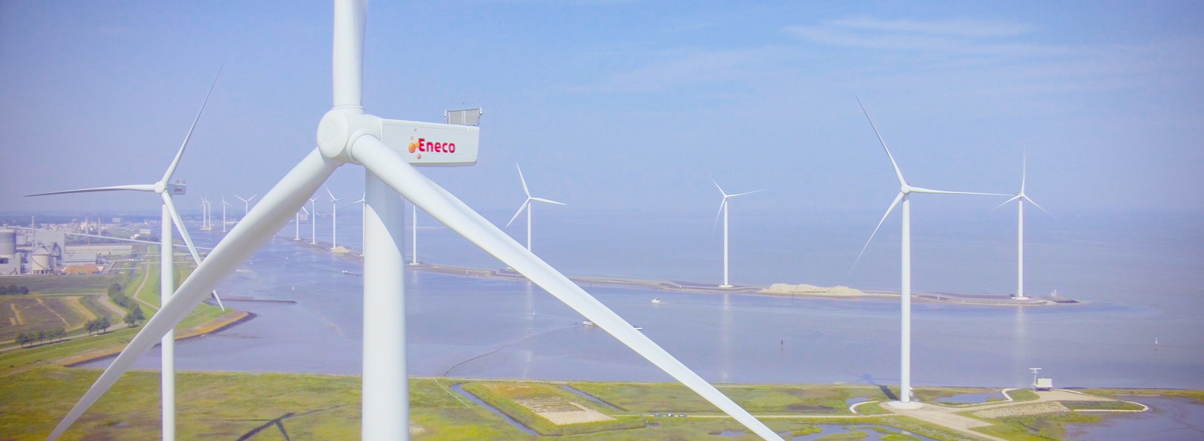
Utility company with data. Lots of it.
Interesting mix of operational, real time systems in physical environments, large scale enterprise systems for 1000s of internal professionals and millions of external consumers – with a mission to improve the world

Slide 53









Utility Company looking for Performance, Scalability and Availability in their core data sets
Marketing Campaigns
Invoicing
CRM
Billing
batch
Meter Readings
Load on Core Systems & effect on Performance
Availability Core Systems

Slide 54
Utility Company looking for Performance, Scalability and Availability in their core data sets
Marketing Campaigns
CRM
Invoicing
CRM Cache DB
Meter Readings
Billing
Meter Readings Cache DB

Slide 55


Utility Company looking for Performance, Scalability and Availability in their core data sets
Marketing Campaigns
CRM
Invoicing
CRM Cache DB
Meter Readings
Billing
Meter Readings Cache DB

Slide 56
Other Kafka Consumers
Data Lake
Marketing Campaigns
CRM
Invoicing
CRM Cache DB
Meter Readings
Billing
Meter Readings Cache DB

Slide 57
Practical Challenges
Marketing Campaigns
Publish all change events from sources
Event schema evolution
Lag in Cache Databases
“eventual consistency”
Differences between sources and cache databases
Initial creation of Cache Databases
General Scale and Incidental event storm
Business and Mission Critical availability
Data Authorization
Logic enforced in source (applications)
GDPR
CRM
Invoicing
CRM Cache DB
Meter Readings
Billing
Meter Readings Cache DB

Slide 58
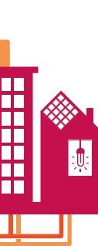

Bridging OT & physical world => Enterprise IT
Communication Module
Smart Meter
Smart Meter
HEAT

Slide 59

Bridging OT & physical world => Enterprise IT
Monitoring
Ingest, Authenticate & Check
Validate, Enrich Process, Convert, Publish
Communication Module
Smart Meter
Smart Meter
Devices
Telemetry
HEAT
IoT Platform

Slide 60
Bridging OT & physical world => Enterprise IT
Monitoring
Validate, Enrich Process, Convert, Publish
Event Streaming Platform
Communication Module
Ingest, Authenticate & Check
Smart Meter
Smart Meter
Devices
Telemetry
HEAT
IoT Platform

Slide 61
Bridging OT & physical world => Enterprise IT
Monitoring
Invoicing
Capacity Planning
Customer App/Portal/API
Heat Grid Analysis
Data Science
Customer Service/Helpdesk
Validate, Enrich Process, Convert, Publish
Event Streaming Platform
Communication Module
Ingest, Authenticate & Check
Smart Meter
Smart Meter
Devices
Telemetry
HEAT
IoT Platform

Slide 62
Orders of magnitude
Monitoring
150K devices
12M events/day
Validate, Enrich Process, Convert, Publish
Event Streaming Platform
Communication Module
Ingest, Authenticate & Check
Smart Meter
3.5M msg/day
API
Smart Meter
Devices
Telemetry
Actuator
70M records/day
HEAT
70M measurements/day

Slide 63
Bank – Fraud detection in ATM transactions
Every ATM transaction request
is handled synchronously – check account, create transaction, …
is published to be evaluated for potential fraud
to a Kafka Topic
fraud detection has 800 ms to put a stop to the transaction
fraud detectors run in a consumer group working in parallel to analyze transactions

Slide 64
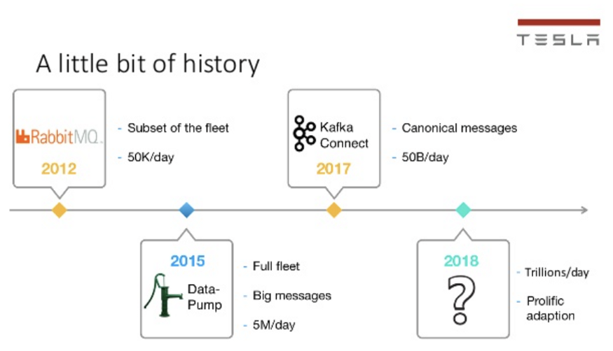
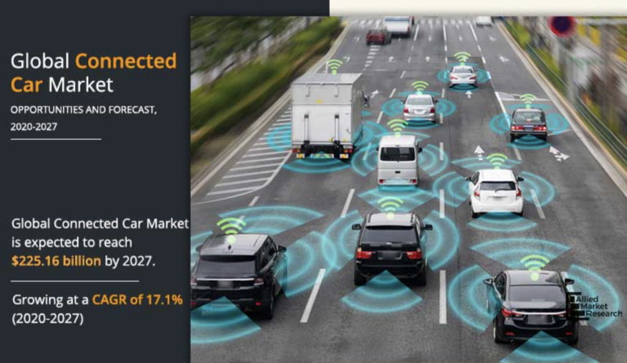
Some Kafka Use Cases
Connected Cars, Manufacturing, Mobility, Gaming, Betting
Tesla: Processing and analyzing the data from their vehicles, smart grids, and factories and integrating with the rest of the IT backend services in real-time is a crucial piece of Tesla’s success
https://kai-waehner.medium.com/when-not-to-use-apache-kafka-a35345226a9f

Slide 65
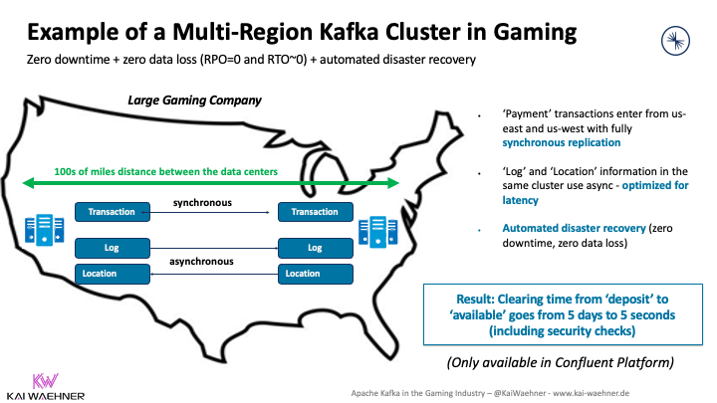
Some Kafka Use Cases
Connected Cars, Manufacturing, Mobility, Gaming, Betting
Regulatory compliance and zero data loss are crucial.
transactionally safe data replication
https://kai-waehner.medium.com/when-not-to-use-apache-kafka-a35345226a9f

Slide 66
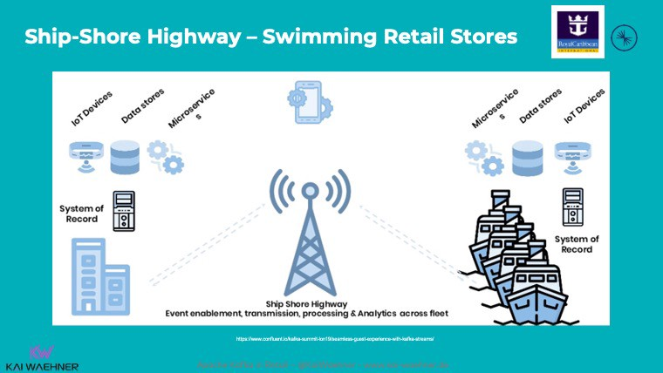
Some Kafka Use Cases
Connected Cars, Manufacturing, Mobility, Gaming, Betting
Royal Caribbean: Each cruise ship has a Kafka cluster running locally for use cases such as payment processing, loyalty information, customer recommendations, etc. Sync with shore when entering a port.
https://kai-waehner.medium.com/when-not-to-use-apache-kafka-a35345226a9f

Slide 67

Data Streaming
Continuously Analyzing and Processing Data without storing it

Slide 68
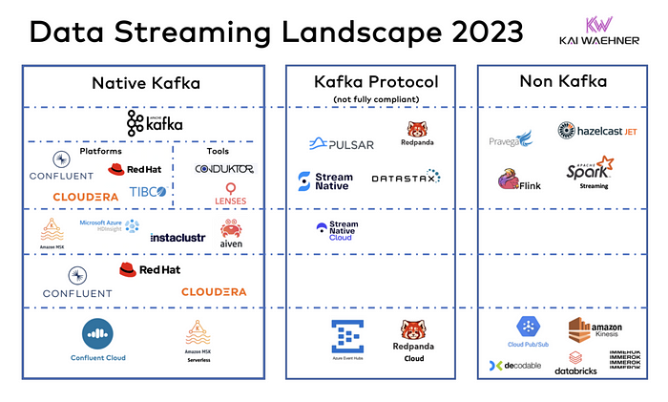
Data Streaming

Slide 69
Data Streaming

Slide 70


Quick Demo – Apache Kafka in action
Show interaction at the most basic level
Broker
Topic
single partition
Produce Message
Consume Message
Work with multiple partitions and a Consumer Group
Show AK HQ Web UI
9092
Docker Compose
28042
Browser
Terninal
workspace

Slide 71
Handson – Trying your hand at Apache Kafka
Using Kafka Console and Kafkacat (kcat) CLI
Create a topic
Publish messages to topic
Consume messages from topic
Work with Apache Kafka HQ GUI to
inspect the Kafka Cluster
produce additional messages
Multiple Partitions & Consumer Groups
distribution across partitions
parallel message consumption by consumers teaming up in a Consumer Group
9092
Docker Compose
29092
28042
Browser
Terninal
workspace

Slide 72
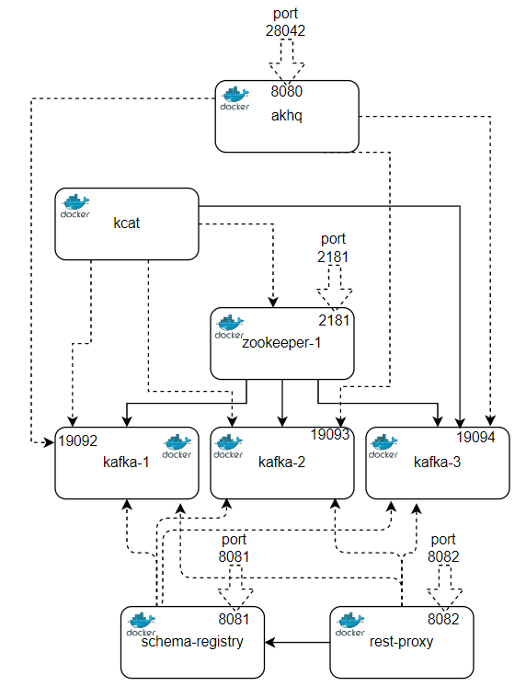
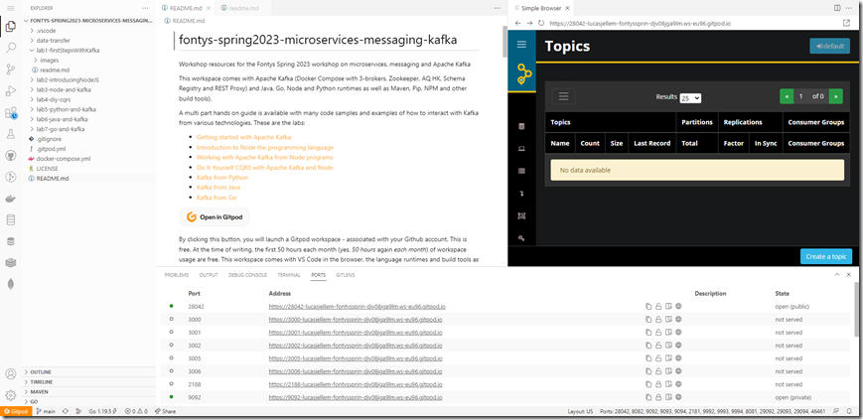
Workshop Environment
Launch GitHub lab repo into Gitpod workspace
workspace has VS Code, Docker Compose, containerized Kafka Cluster and language build and runtimes
GitHub repository: github.com/lucasjellema/fontys-spring2023-microservices-messaging-kafka
gitpod.io#https://lucasjellema/fontys-spring2023-microservices-messaging-kafka
workspace

Slide 73






Workshop Environment

Slide 74
Overview
Introduction to messaging and Apache Kafka
Asynchronous communication – Messaging for people and systems
Introducing Apache Kafka – what, why, when, how
Handson with Apache Kafka
Microservices
Handson Asynchronous interactions through Node and Apache Kafka
also: Python, Java, Go

Slide 75

What is a microservice?
Why is a microservice?
Problems with (BIG) applications
complex
inflexible to change (when roll out changes)
long test, long build
impossible to upgrade technology (everything is affected)
hard to scale
hard to migrate (to different technology)
hard to learn (for new staff)

Slide 76

Final Demo
Microservices
Microservice

Slide 77
What is a microservice?
Not TOO big (but not too small either)
understandable by normal human beings – easy to on board new team members
easy to change – allow for agile functional and non functional evolution
functionally cohesive/logical collection of features => domain
design time decoupled, clear standards based external interfaces: API & events
low external impact of: change, refactor, move, migrate, scale, failure
reliable, robust, resilient
clear ownership (business sponsor; one IT team builds it, runs it, evolves it)
contains everything needed to run [on a generic platform]
application software, libraries/frameworks, platform configuration
pipelines for CI and CD, tests, documentation, infra as code

Slide 78
The Microservice
HTTP REST/JSON
API
µ

Slide 79
Extended API of microservice
API
Deployment Interface
Injectable dependencies – reference to cache, logging, storage URL, …
Configurable meta-data – run time parameters, log level, credential (key)
Runtime Interaction Interface
REST API Resources & Operations – query and URL parameters, message formats
Events Consumed – alternative way to call | activate a microservice
Reference to entry in Event Catalog
May include reference to shared Cache Resource
Events Produced – alternative output from microservice
Event can be an asynchronous response to a stateless consumer

Slide 80
Interaction between Microservices
synchronous, route (& discover), retry, load balance, cache, monitor, authorize, TLS
API Gateway | Service Mesh
API
API
Event Broker
asynchronous, persistent, reliability guarantees

Slide 81
Interaction between Microservices
API Gateway | Service Mesh
API
API
Event Broker

Slide 82



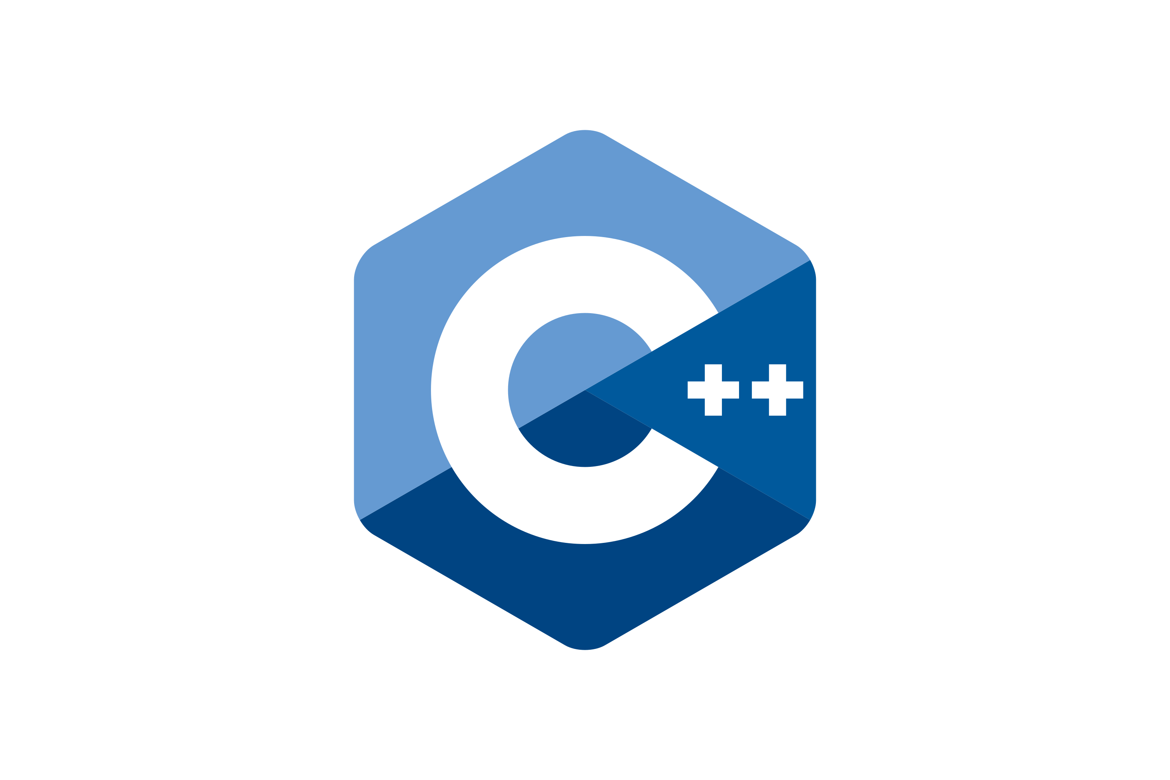









Interaction between Microservices
API Gateway | Service Mesh
API
API
Event Broker
Kafka
Redis
Azure
Service Bus
RabbitMQ
GCP
Pub/Sub

Slide 83
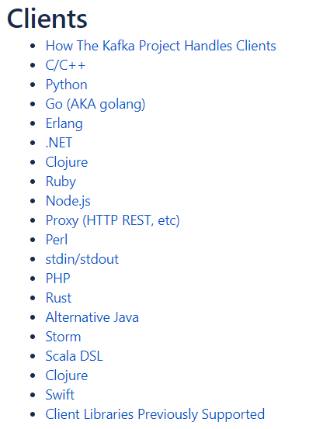









Programming against Kafka: Client Libraries
Client libraries
C/C++
Python
Go
Java
.NET
JavaScript/Node
Ruby
Scala
and more..
Also: REST Proxy (part of open source Confluent Platform)
Produce, Consume and manage through REST API calls
Notes:
https://cwiki.apache.org/confluence/display/KAFKA/Clients

Slide 84
Programming against Kafka: Typical Steps in a Client Producer Application
Create a connection
connected to one or more brokers in a cluster or to the Zookeeper node
you need the broker-endpoints or the Zookeeper endpoint
optionally use credentials or certificate for authentication
Create a Producer on top of the connection
When the Producer-Connection is available…
[Optionally] Start a Transaction
Produce message[s] to topic(s) [or specific topic partition(s)]
[Optionally] Commit the Transaction
[Repeat Message Production]
Disconnect the producer/close the connection
2181
9092
9093
9094
Client
Application
Notes:
https://cwiki.apache.org/confluence/display/KAFKA/Clients

Slide 85
Programming against Kafka: Typical Steps in a Client Consumer Application
Create a connection
connected to one or more brokers in a cluster or to Zookeeper node
you need the broker-endpoints or the Zookeeper endpoint
optionally use credentials or certificate for authentication
Create a Consumer or a ConsumerStream on top of the connection
Subscribing to one or more topics
[Optionally] Associating with a Consumer Group
Which leads to a link to one or more partitions
[Optionally] Overriding the auto-commit
When the Consumer or Stream is available…
Consume message[s] (from the specified subscriptions)
[Optionally, depending on auto-commit poperty] Commit the Transaction
[Repeat Message Consumption]
Disconnect the consumer/close the connection
2181
9092
9093
9094
Client
Application
Notes:
https://cwiki.apache.org/confluence/display/KAFKA/Clients

Slide 86
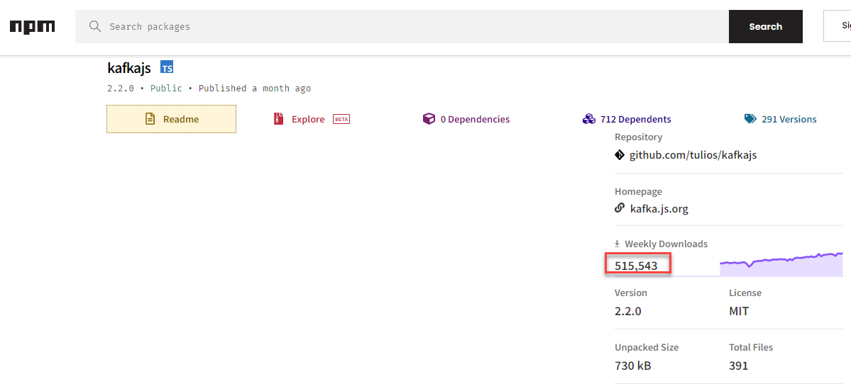
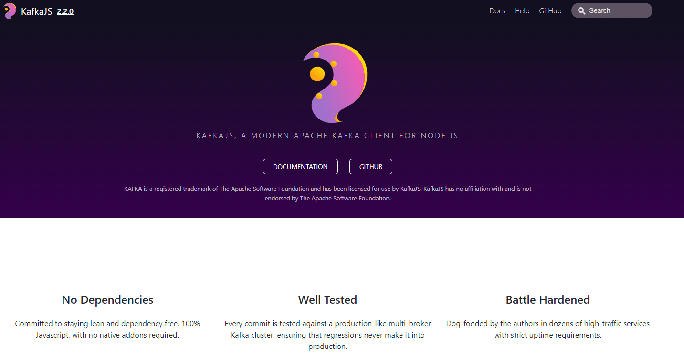
Node and Kafka
We will use NPM module kafkajs to facilitate the interaction with Apache Kafka from our Node application
This module is small, stand alone and well proven

Slide 87
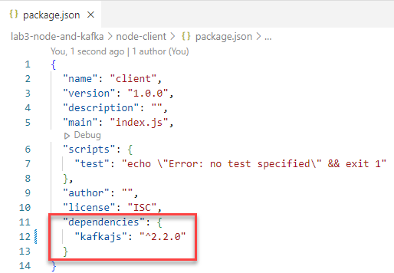
Node and Kafka – a simple producer

Slide 88
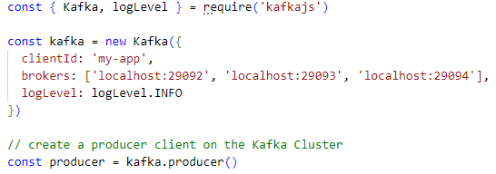
Node and Kafka – a simple producer
29092
29093
29094
localhost

Slide 89
Node and Kafka – a simple producer

Slide 90
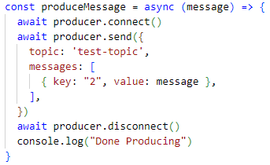
Node and Kafka – a simple producer

Slide 91
Node and Kafka – a simple producer
1
2
test-topic
29092
29093
29094
2
1
Client
Application

Slide 92
Consumer

Slide 93
Consumer
const { Kafka, logLevel } = require('kafkajs')

Slide 94
Consumer
const { Kafka, logLevel } = require('kafkajs')
consumeMessages()

Slide 95
Consumer
const { Kafka, logLevel } = require('kafkajs')
const kafka = new Kafka({
clientId: 'my-app',
brokers: ['localhost:29092', 'localhost:29093', 'localhost:29094'],
logLevel: logLevel.INFO
})
consumeMessages()

Slide 96
Consumer
const { Kafka, logLevel } = require('kafkajs')
const kafka = new Kafka({
clientId: 'my-app',
brokers: ['localhost:29092', 'localhost:29093', 'localhost:29094'],
logLevel: logLevel.INFO
})
const consumeMessages = async () => {
const consumer = kafka.consumer({ groupId: 'test-group' })
}
consumeMessages()

Slide 97
Consumer
const { Kafka, logLevel } = require('kafkajs')
const kafka = new Kafka({
clientId: 'my-app',
brokers: ['localhost:29092', 'localhost:29093', 'localhost:29094'],
logLevel: logLevel.INFO
})
const consumeMessages = async () => {
const consumer = kafka.consumer({ groupId: 'test-group' })
await consumer.connect()
await consumer.subscribe({ topic: 'test-topic', fromBeginning: true })
...
}
consumeMessages()

Slide 98
Consumer
const { Kafka, logLevel } = require('kafkajs')
const kafka = new Kafka({
clientId: 'my-app',
brokers: ['localhost:29092', 'localhost:29093', 'localhost:29094'],
logLevel: logLevel.INFO
})
const consumeMessages = async () => {
const consumer = kafka.consumer({ groupId: 'test-group' })
await consumer.connect()
await consumer.subscribe({ topic: 'test-topic', fromBeginning: true })
await consumer.run({
eachMessage: ...
})
}
consumeMessages()

Slide 99
Consumer
const { Kafka, logLevel } = require('kafkajs')
const kafka = new Kafka({
clientId: 'my-app',
brokers: ['localhost:29092', 'localhost:29093', 'localhost:29094'],
logLevel: logLevel.INFO
})
const consumeMessages = async () => {
const consumer = kafka.consumer({ groupId: 'test-group' })
await consumer.connect()
await consumer.subscribe({ topic: 'test-topic', fromBeginning: true })
await consumer.run({
eachMessage: async ({ topic, partition, message }) => {
const prefix = `${topic}[${partition} | ${message.offset}] / ${message.timestamp}`
console.log(`- ${prefix} ${message.key}#${message.value}`)
},
})
}
consumeMessages()

Slide 100
Consumer
const { Kafka, logLevel } = require('kafkajs')
const kafka = new Kafka({
clientId: 'my-app',
brokers: ['localhost:29092', 'localhost:29093', 'localhost:29094'],
logLevel: logLevel.INFO
})
const consumeMessages = async () => {
const consumer = kafka.consumer({ groupId: 'test-group' })
await consumer.connect()
await consumer.subscribe({ topic: 'test-topic', fromBeginning: true })
await consumer.run({
eachMessage: async ({ topic, partition, message }) => {
const prefix = `${topic}[${partition} | ${message.offset}] / ${message.timestamp}`
console.log(`- ${prefix} ${message.key}#${message.value}`)
},
})
}
consumeMessages()
test-topic
29092
29093
29094
2
3
1
Client
Application
1
2
3

Slide 101
Hands On Lab 2 and 3
Explore Node
Explore Node interacting with Apache Kafka
Consume from and Produce messages to Kafka Topic from Node
Multiple producers and some collaborating consumers
From Web UI to Kafka Topic to Web UI/API
Client
Application
Produce
2
1
test-topic
29092
29093
29094
Consume
2
3
1
Client
Application
labs: github.com/lucasjellema/fontys-spring2023-microservices-messaging-kafka

Slide 102
Lab 4 - DIY CQRS – Decoupled Microservice Interaction
Handles new and changed customer details – including Connection Mandate Setting for Connection Identifier
REST API Call to POST/PUT or GET customer details including Mandate
REST API Call to GET Mandate Setting
Publish Event to Kafka Topic for every new or changed Connection Mandate Setting
CRM
IoT Platform
Consume Event and Record new Mandate Setting for Connection Identifier
Need to have the SmartMeter Mandate Setting for every ConnectionId
Initial data load from file
csv
connection-mandates-topic

Slide 103
Hands On Lab 5, 6, 7 and 8
Explore Python, Java, Go and .NET interacting with Apache Kafka
Consume from and Produce messages to Kafka Topic from any language
Client
Application
Client
Application
Client
Application
Produce
2
2
1
2
1
1
test-topic
29092
29093
29094
Consume
2
3
1
1
2
Client
Application
3
Client
Application
labs: github.com/lucasjellema/fontys-spring2023-microservices-messaging-kafka

Slide 104

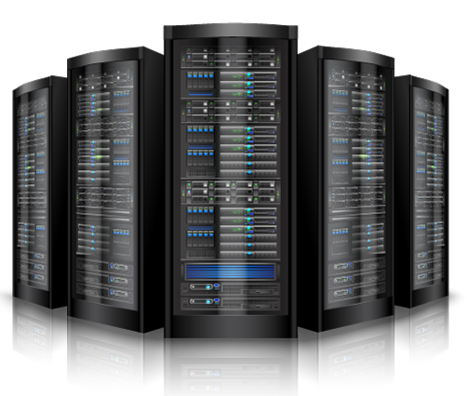


Summary
=> == =>
Apache Kafka has evolved into platform of choice for message exchange in a world of
Microservices
Event Sourcing, CQRS and Data Source Synchronization
Clouds
Fast Data (IoT) and Streaming Analysis
Real time data integration & distribution
Getting started with Apache Kafka is not very hard at all
The platform is open source – and has broad client support (Java, Node, …)
Many resources are available – tutorials, blog article, demonstrations, presentation slides and recordings of conference sessions, samples on GitHub
Using Docker Compose (and Gitpod) it is quite easy to quickly run a Kafka Cluster
Note: managing a production grade cluster is not so easy

Slide 105


lucas.jellema@amis.nl | technology.amis.nl | @lucasjellema | lucas-jellema
you are invited to come do an internship and explore job opportunities with us!

